Slide 1
DR SNSRCAS, CBE Software Engineering 21UCA408 II BCA B UNIT II Requirements Engineering

Slide 2
Requirements Engineering
What is requirements engineering?
Clients have a long list of goals when creating new software, and RE provides a framework for meeting those goals. Important needs are inventoried and transformed into a detailed set of requirements. Requirements development dictates future development activities and creates a blueprint for success.
The terms “requirements management” and “requirements engineering” are often used interchangeably, but they are different. RM is one piece of requirements engineering, and getting it right makes all the difference.
RE ensures that the problem a client wants solved is clearly defined and the solution is both accurate and effective. Essentially, RE transforms a real-world problem into a highly functional software solution.

Slide 3
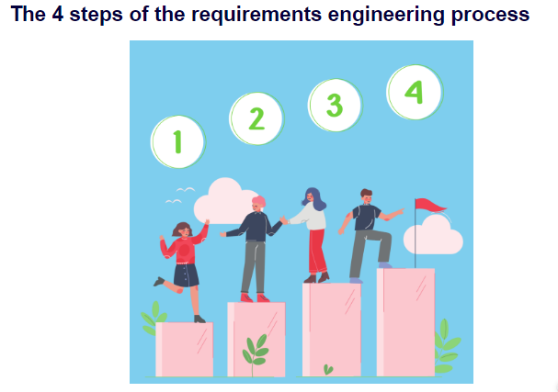
Requirements Engineering

Slide 4
Requirements Engineering
The requirements engineering process has many potential pitfalls. Strengthening your RE process enables you to avoid many common challenges. The process serves as a compass, guiding you in determining the exact deliverables and doing so with greater accuracy. All important parties are on the same page about what steps need to be taken to achieve the desired outcome. Strengthen your RE process by considering the following:
Elicit requirements. Elicitation is about becoming familiar with all the important details involved with the project. The customer will provide details about their needs and furnish critical background information. You will study those details and also become familiar with similar types of software solutions. This step provides important context for development.

Slide 5
Requirements Engineering
Requirements specification. During the specification phase, you gather functional and nonfunctional project requirements. A variety of tools are used during this stage, including data flow diagrams, to add more clarity to the project goals.
Verification and validation. Verification ensures the software is built to the customer’s requirements. In contrast, validation ensures the software is implementing the right functions. If the requirements don’t go through the validation stage, there is the potential for time-consuming and expensive reworks.

Slide 6
Requirements Engineering
Requirements management. RM is an ongoing process that runs in parallel to the other three processes just described. In RM, you’re matching all the relevant processes to their requirements. You will analyze, document, and prioritize the requirements – and communicate with relevant stakeholders. Any requirements that need modification are handled in an efficient and systematic manner.
As you implement the different components of RE, it also helps you get a sense of what should be excluded from requirements. Understanding this will help you focus more accurately on developing requirements and better meeting client expectations.

Slide 7
Requirements Engineering
What information should be excluded from the requirements?
Requirements should be viewed as addressing a problem but not necessarily as providing a solution. A requirement should clearly state what you want to solve, not how you want to solve it. Let’s take a look at guidelines for good requirements:
The requirement accurately defines the need of the stakeholder.
The requirement is testable.
A requirement needs to be clear and understandable, without the risk of ambiguity. An important step in developing good requirements is the review process. Does the requirement accurately express the needs of the stakeholders? Make sure to build in enough client reviews so that you can get early feedback and adjust as needed.

Slide 8
THANK YOU

